Slide 1
Digital Communication 24EC2208
Spread-Spectrum Communications

Slide 2
Frequency Hop Spread Spectrum

Slide 3
Limitations of DSSS BPSK Modulation
Use of PN sequence achieves instantaneous spreading of the transmission bandwidth to combat the effects of jammers that is determined by the processing gain Gp of the system which is a function of chip period (PN Sequence).
The Gp can be increased by narrowing chip duration, but limited capabilities of physical device to implement.
Indeed, the processing gain so attained is not sufficient to achieve large bandwidth.
To overcome these limitations, frequency hopping spread spectrum is proposed.

Slide 4
Frequency Hop Spread Spectrum
The type of spread spectrum on which the carrier hops randomly from one frequency to another is referred to as FHSS.
In FHSS the spectrum of transmitted signal is spread sequentially rather than instantaneously as in DSSS.
A common modulation format for FH system is that M-ary FSK or MFSK.
The combination of two techniques is referred to as FH/MFSK.
Since FH does not cover the entire spread spectrum instantaneously that leds to consider the rate at which the hops occur.

Slide 5


Frequency Hop Spread Spectrum
Two Basic Characteristics:
Slow frequency hopping in which symbol rate of MFSK signal is an integer multiple of hop rate . That is several symbols are transmitted on each frequency hop.
Fast frequency hopping in which hop rate of MFSK signal is an integer multiple of symbol rate . That is the carrier frequency will change or hop several times during the transmission of one symbol.
Generally fast FHSS gives improved performance in noise (or jamming)

Slide 6
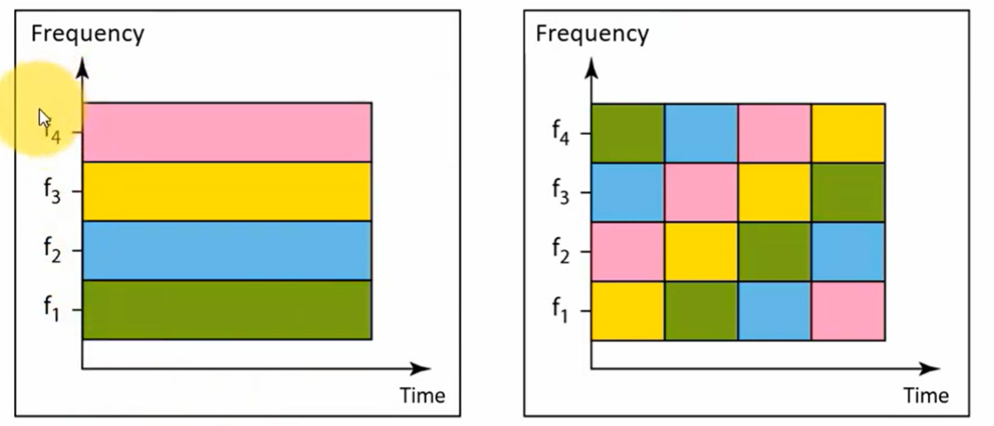
FDM
FHSS

Slide 7
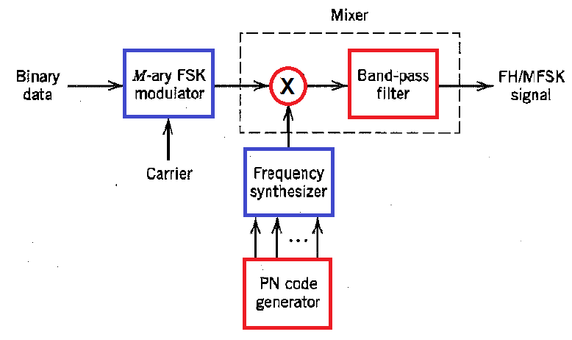


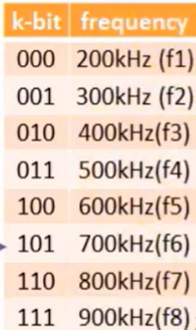



Slow Frequency Hop Spread Spectrum
Transmitter

Slide 8
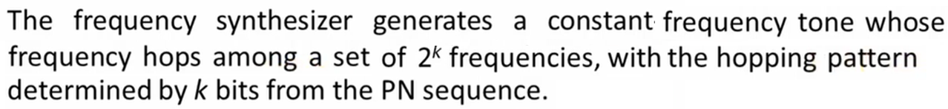
FHSS Transmitter

Slide 9
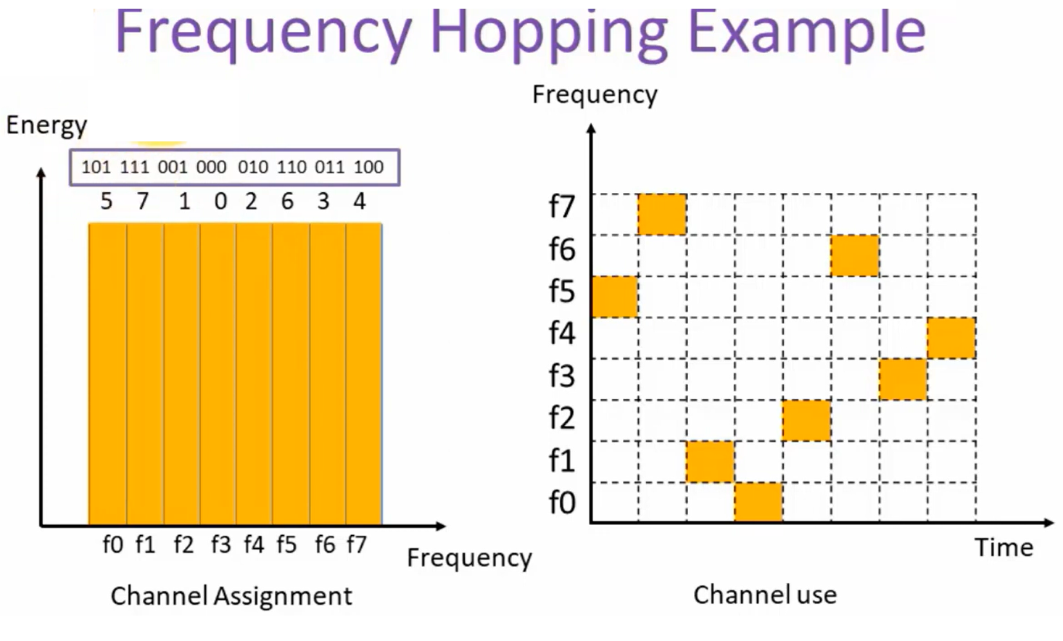

Slide 10
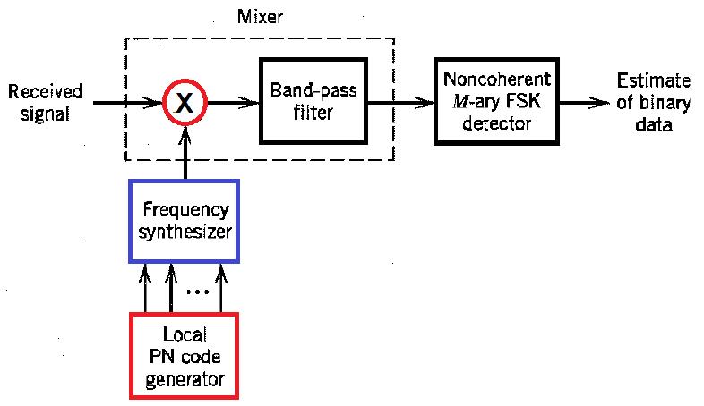


Slow Frequency Hop Spread Spectrum
Receiver

Slide 11
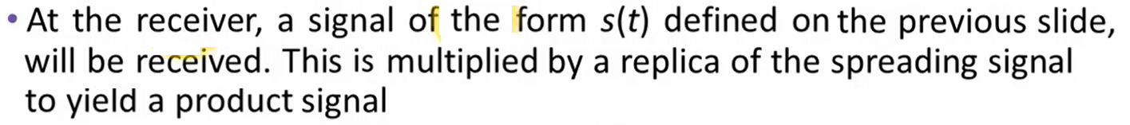

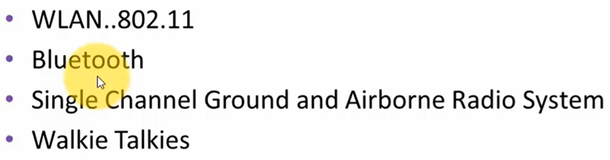
FHSS Receiver

Slide 12
End

